Slide 1
Song Genre
Classifier
HOME
TABLE OF CONTENTS
PLAYLIST
01
Data Preprocessing
02
EDA
03
Methodology
04
Results
<Key , Val> Knights
THANKS!

Slide 2
Introduction
HOME
TABLE OF CONTENTS
PLAYLIST
01
Data Preprocessing
02
EDA
This project utilizes big data analytics to address the intricate challenge of classifying song genres.
our approach harnesses the wealth of information embedded within the audio features and lyrical content of songs.
03
Methodology
04
Results
THANKS!

Slide 3
Our team
Ahmed Mohamed Saad
Ali Khalaf
HOME
TABLE OF CONTENTS
PLAYLIST
Data Preprocessing
01
02
EDA
Hazem Montasser
03
Methodology
04
Results
THANKS!

Slide 4
Table of contents
Data Preprocessing
Exploratory Data Analysis (EDA)
01
02
Methodology
Results
03
04
HOME
TABLE OF CONTENTS
PLAYLIST
01
Data Preprocessing
02
EDA
03
Methodology
04
Results
THANKS!

Slide 5
01
Data Preprocessing
HOME
TABLE OF CONTENTS
PLAYLIST
Data Preprocessing
01
02
EDA
03
Methodology
04
Results
THANKS!

Slide 6
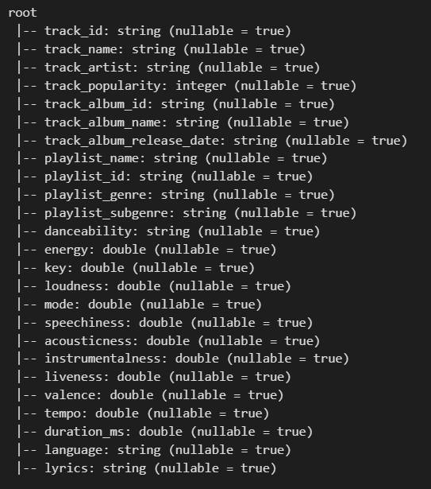
Dataset Original Schema
HOME
TABLE OF CONTENTS
PLAYLIST
01
Data Preprocessing
02
EDA
03
Methodology
04
Results
THANKS!

Slide 7
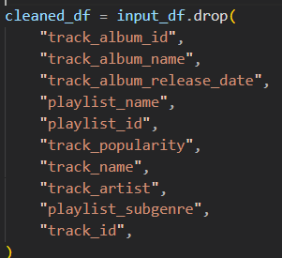
1- General Steps:
HOME
TABLE OF CONTENTS
1- Remove Unnecessary Columns
2- Remove records with null values
3- Remove records with null values
4- make sure that all features except genre , lyrics have numeric values
PLAYLIST
01
Data Preprocessing
02
EDA
03
Methodology
04
Results
THANKS!

Slide 8
2- Normalization of numeric features:
HOME
TABLE OF CONTENTS
PLAYLIST
01
Data Preprocessing
Our objective was to make all numeric features normalized and their values are in the range [-1 , 1]
02
EDA
Methodology
We used Mapreduce to apply Normalization
03
04
Results
THANKS!

Slide 9
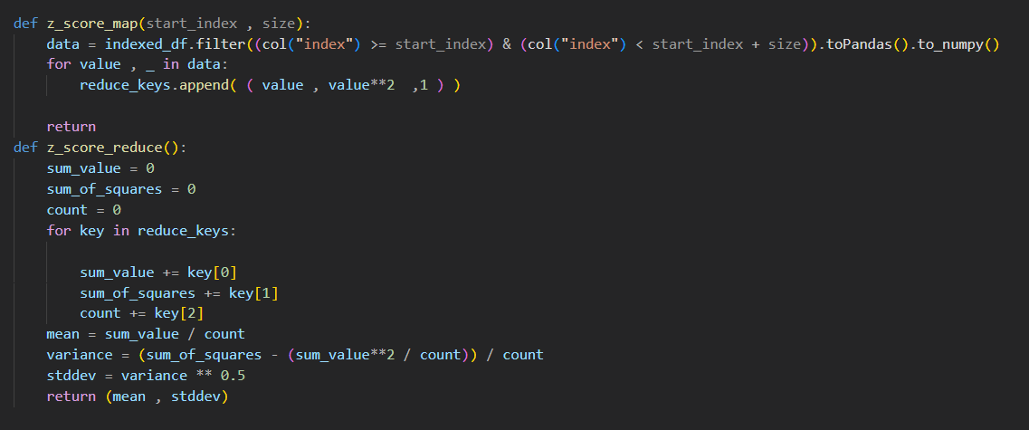
2- Normalization of numeric features (cont):
HOME
TABLE OF CONTENTS
PLAYLIST
01
Data Preprocessing
02
EDA
03
Methodology
04
Results
THANKS!

Slide 10
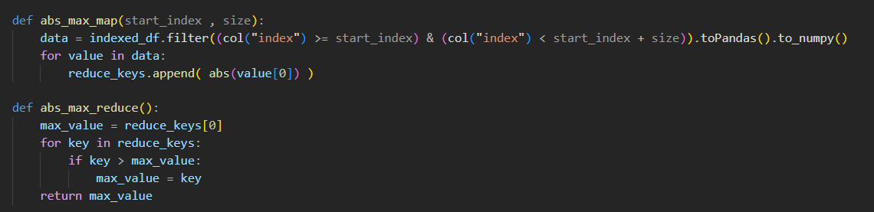
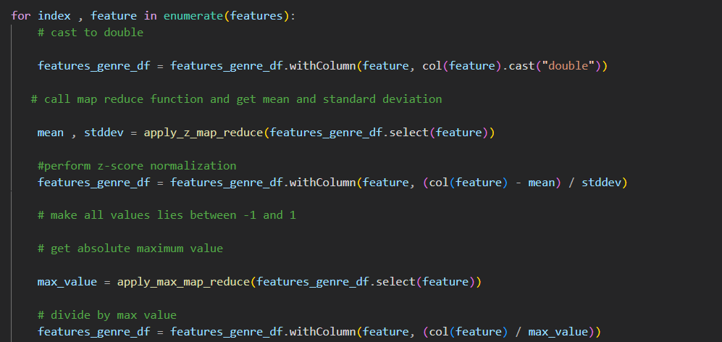
HOME
TABLE OF CONTENTS
PLAYLIST
01
Data Preprocessing
02
EDA
03
Methodology
04
Results
THANKS!

Slide 11
3- Lyrics PreProcessing:
HOME
TABLE OF CONTENTS
PLAYLIST
1- Tokenization
2- Stopwords Removal
3- Text Cleaning
4- Sequence Padding
5- Padding Sequences
6- Embedding Initialization
01
Data Preprocessing
02
EDA
03
Methodology
04
Results
THANKS!

Slide 12
02
EDA
HOME
TABLE OF CONTENTS
PLAYLIST
Data Preprocessing
01
02
EDA
03
Methodology
04
Results
THANKS!

Slide 13
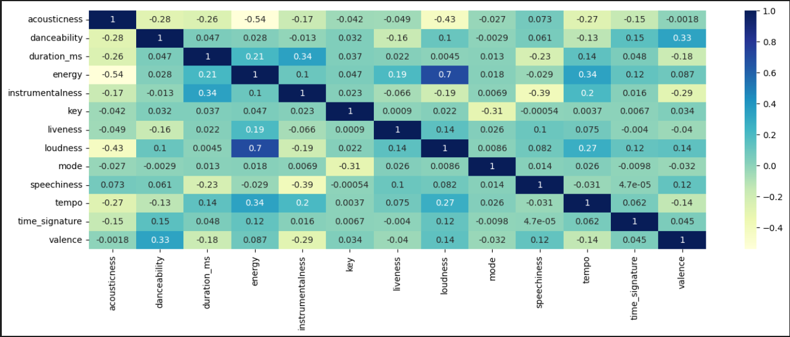
EDA
HOME
TABLE OF CONTENTS
Cross-Correlation Matrix
PLAYLIST
01
Data Preprocessing
02
EDA
03
Methodology
04
Results
THANKS!

Slide 14
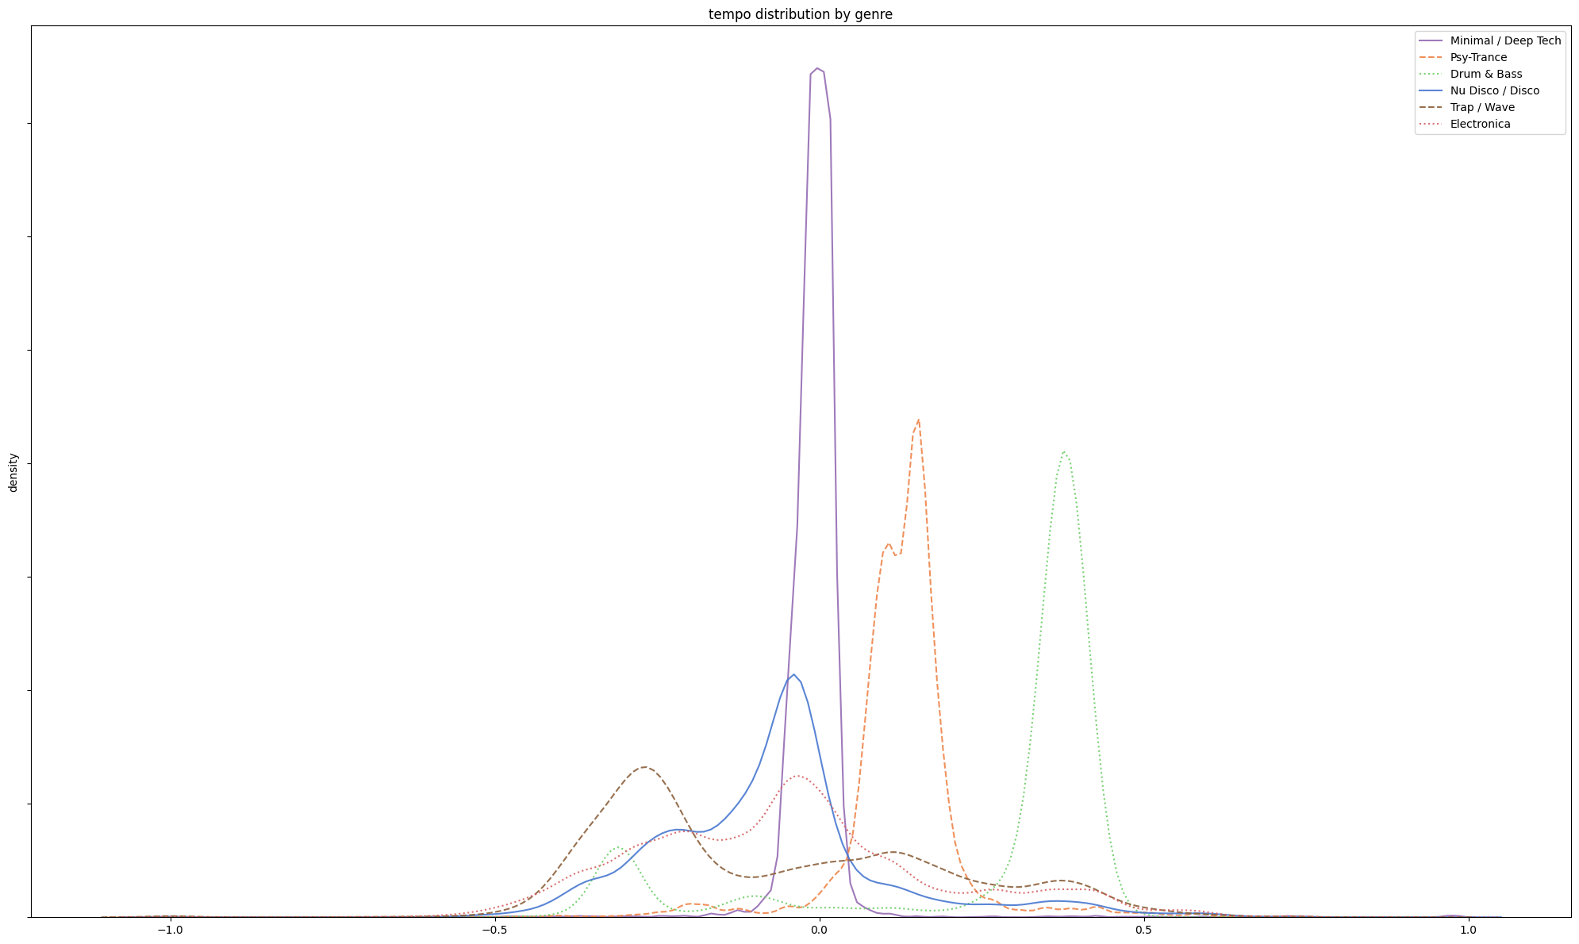
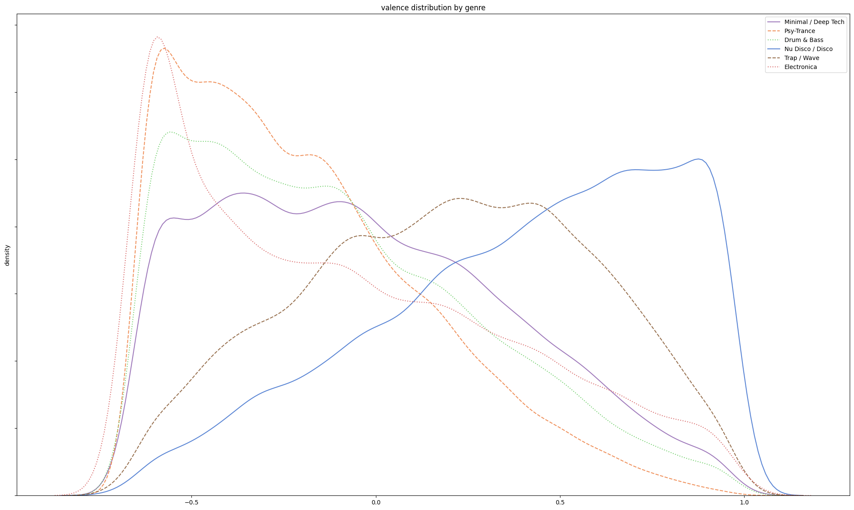
EDA
HOME
TABLE OF CONTENTS
KDE plot per feature (Good Features)
PLAYLIST
01
Data Preprocessing
02
EDA
03
Methodology
04
Results
THANKS!
Tempo
Valance

Slide 15
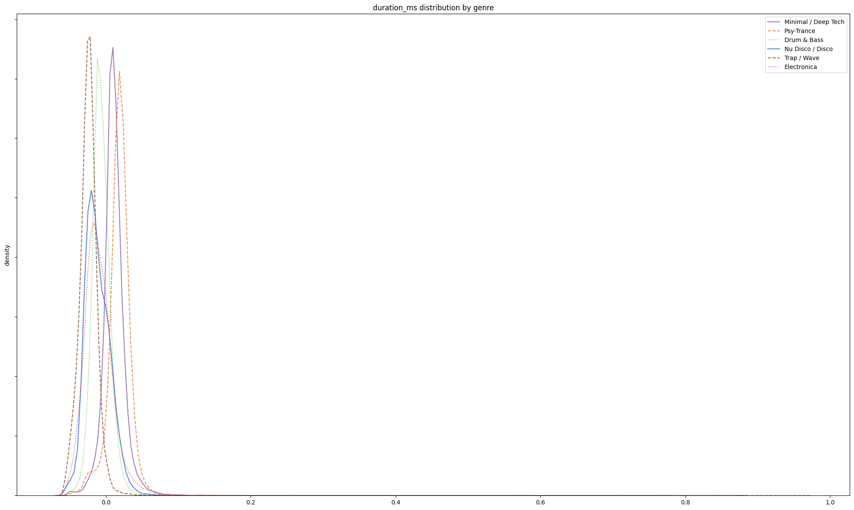
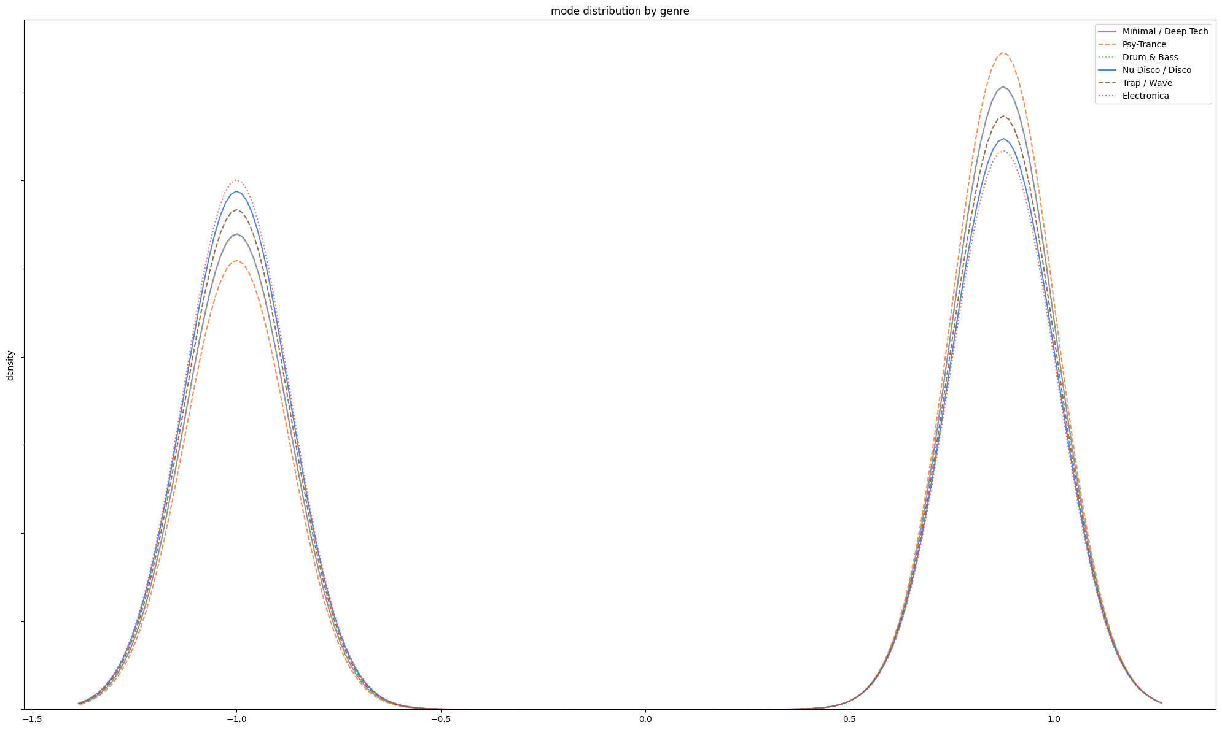
EDA
HOME
TABLE OF CONTENTS
KDE plot per feature (Bad features)
PLAYLIST
01
Data Preprocessing
02
EDA
03
Methodology
04
Results
THANKS!
Duration_ms
Mode

Slide 16
HOME
TABLE OF CONTENTS
In Summary
PLAYLIST
01
Data Preprocessing
we found that some features have nearly no effect on the classification process because the distribution of genres in these features is nearly identical:
These Genres Are : Duration_ms , time_signature and mode
When trying to remove these genres from our classification process they affected only the Random forest classifier by 2%
02
EDA
03
Methodology
04
Results
THANKS!

Slide 17
03
Methodology
HOME
TABLE OF CONTENTS
PLAYLIST
Data Preprocessing
01
02
EDA
03
Methodology
04
Results
This section outlines two approaches designed to classify song genres, each leveraging different sets of features and architectures to achieve the task.
THANKS!

Slide 18
1- Neural Networks Based Classifiers (Used on Old DB):
1- Hybrid Text and Audio Model
2- Audio-Only Model
HOME
TABLE OF CONTENTS
PLAYLIST
01
Data Preprocessing
02
EDA
Methodology
03
04
Results
THANKS!

Slide 19
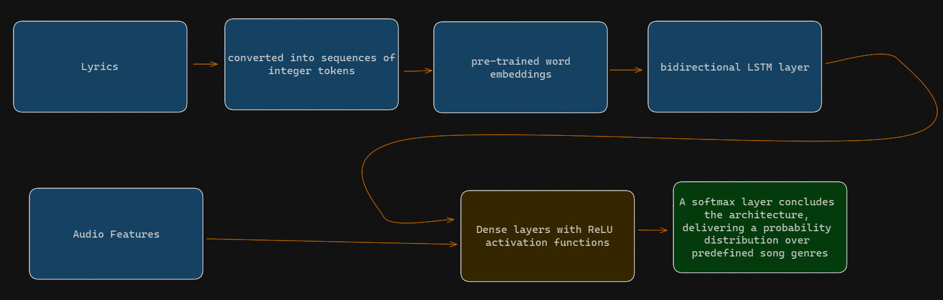
Hybrid Text and Audio Model:
HOME
TABLE OF CONTENTS
PLAYLIST
01
Data Preprocessing
02
EDA
03
Methodology
04
Results
THANKS!

Slide 20
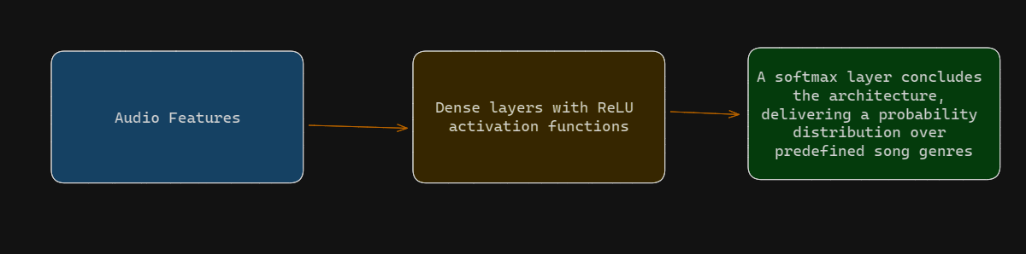
Audio-Only Model
HOME
TABLE OF CONTENTS
PLAYLIST
01
Data Preprocessing
02
EDA
03
Methodology
04
Results
Similar to the LSTM model, this model utilizes the Adam optimizer and categorical cross-entropy loss, aiming for high accuracy in genre classification.
THANKS!

Slide 21
2- Classic Classification Classifiers (Used on New DB):
1- Random Forest
2- Decision Tree
3- Logistic Regression
4- SVM
HOME
TABLE OF CONTENTS
PLAYLIST
01
Data Preprocessing
02
EDA
( numTrees=200, maxDepth=20 )
( maxDepth=30 , maxBins=128 )
03
Methodology
04
Results
(maxIter=100000, regParam=0, elasticNetParam=0)
(kernel="rbf" , break_ties=True )
THANKS!
all this models were trained on 80% of the data and testing was done on the other 20%

Slide 22
04
Results
HOME
TABLE OF CONTENTS
PLAYLIST
Data Preprocessing
01
02
EDA
03
Methodology
04
Results
THANKS!

Slide 23
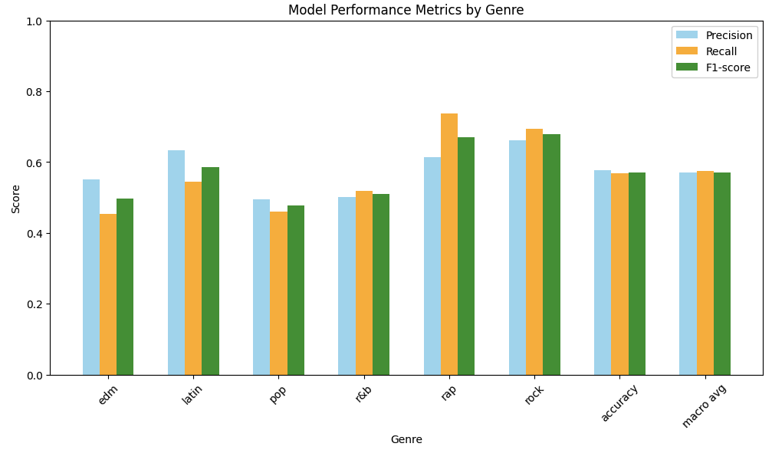
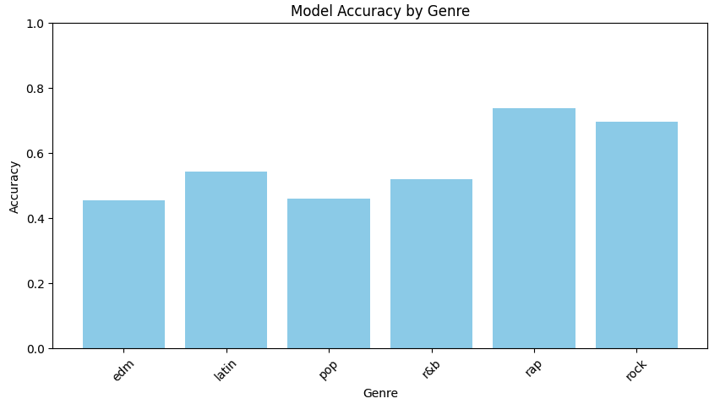
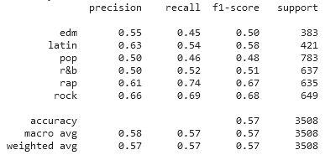
Results(old Dataset)
Model 1: Hybrid Text and Audio Model
HOME
TABLE OF CONTENTS
PLAYLIST
01
Data Preprocessing
02
EDA
03
Methodology
04
Results
THANKS!
AUC Score: 0.8519

Slide 24
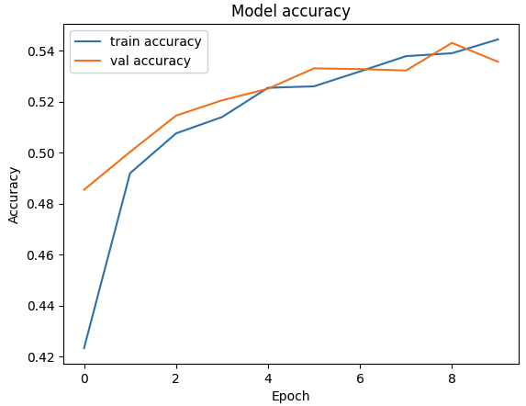
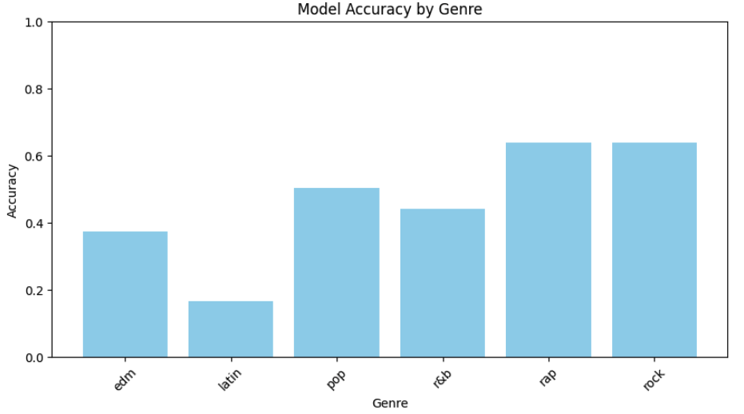
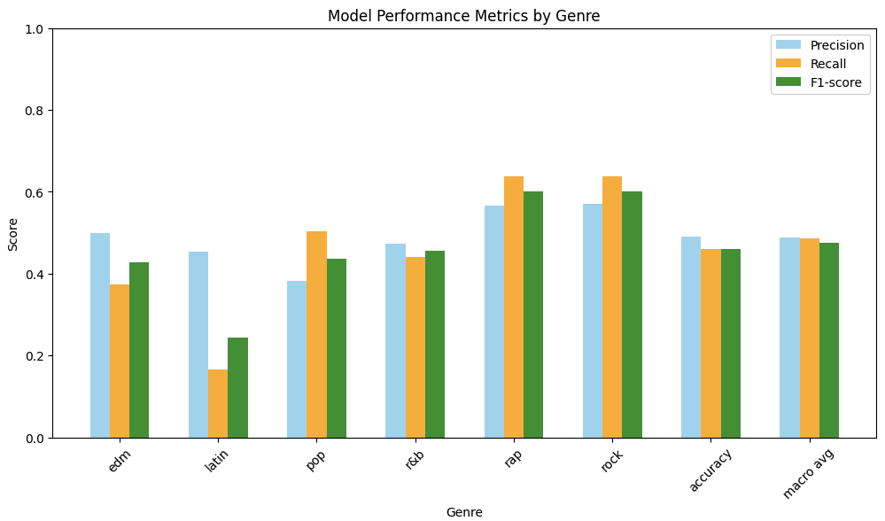
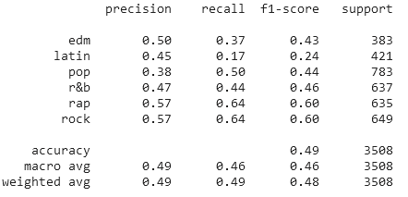
Results(old Dataset)
Model 2: Audio-Only Model
HOME
TABLE OF CONTENTS
PLAYLIST
01
Data Preprocessing
02
EDA
03
Methodology
04
Results
THANKS!
AUC Score: 0.5656

Slide 25
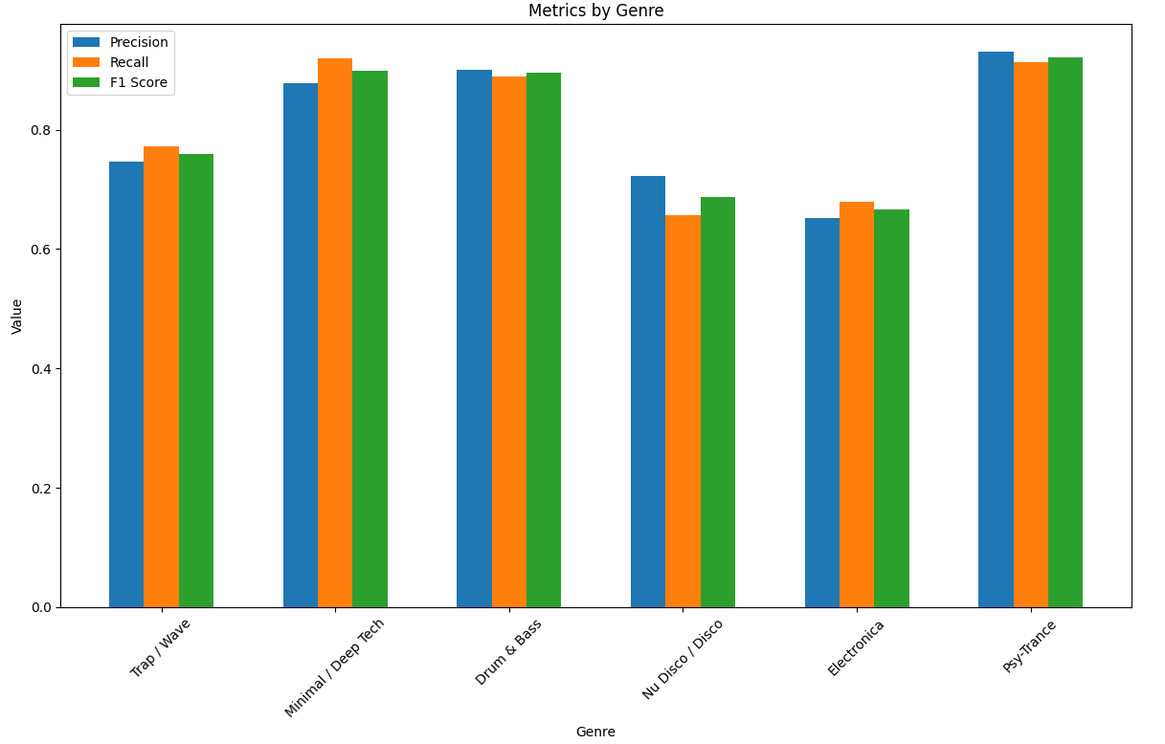
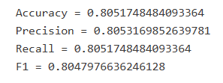
Results(new Dataset)
3- Random Forest
HOME
TABLE OF CONTENTS
PLAYLIST
01
Data Preprocessing
02
EDA
03
Methodology
04
Results
THANKS!

Slide 26
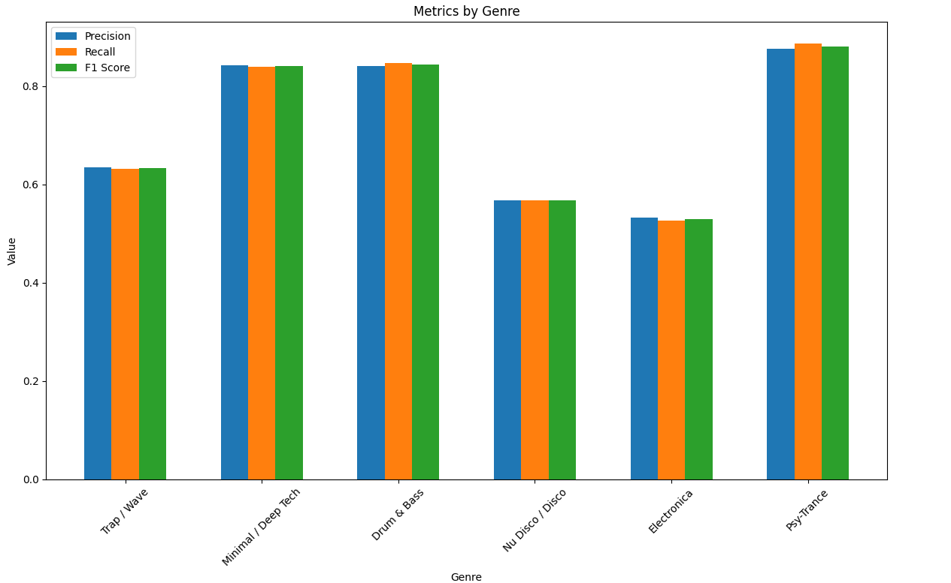

Results(new Dataset)
4- Decision Tree Classifier
HOME
TABLE OF CONTENTS
PLAYLIST
01
Data Preprocessing
02
EDA
03
Methodology
04
Results
THANKS!

Slide 27
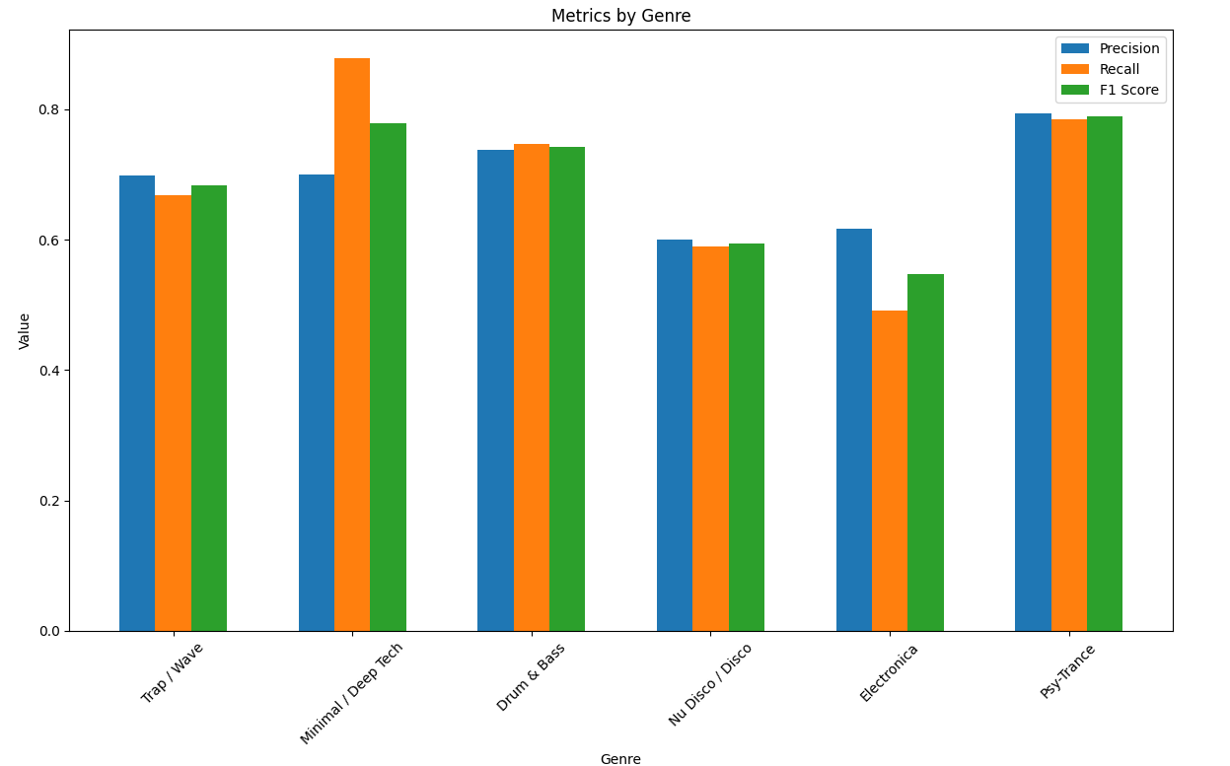
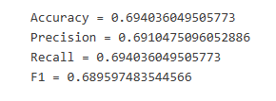
Results(new Dataset)
5- Linear Regression
HOME
TABLE OF CONTENTS
PLAYLIST
01
Data Preprocessing
02
EDA
03
Methodology
04
Results
THANKS!

Slide 28
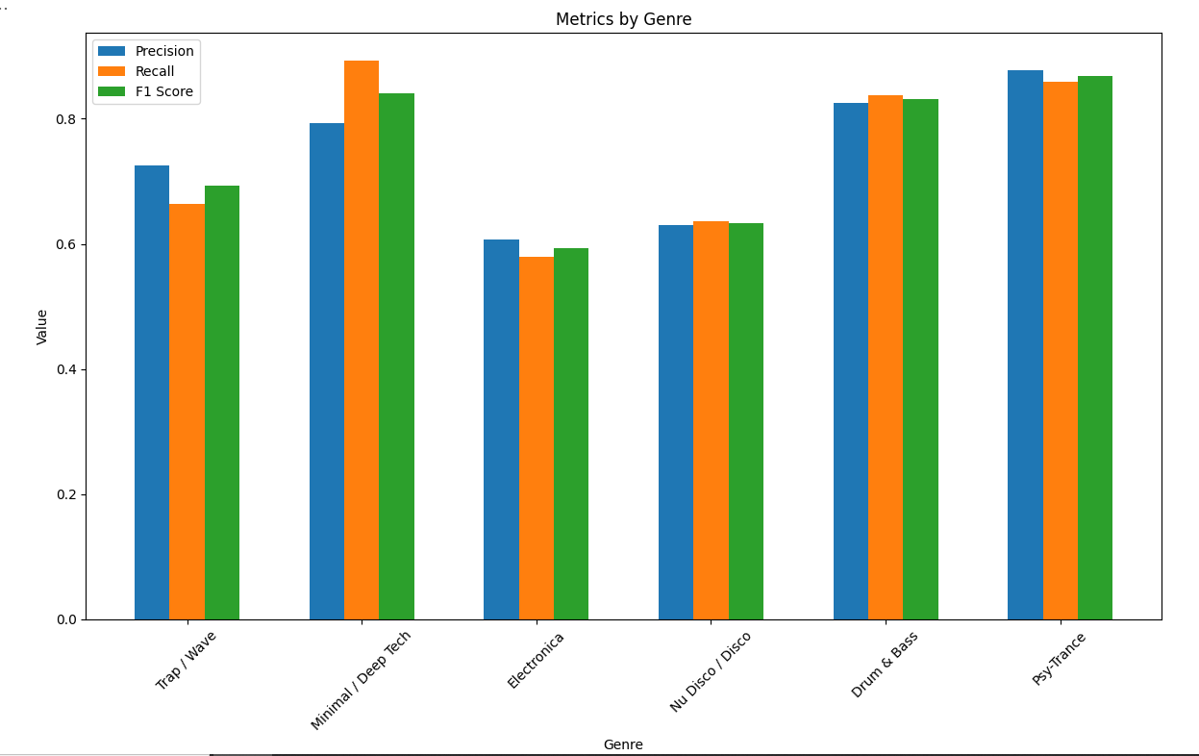
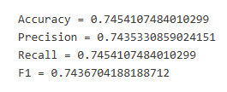
Results(new Dataset)
6- SVM
HOME
TABLE OF CONTENTS
PLAYLIST
01
Data Preprocessing
02
EDA
03
Methodology
04
Results
THANKS!

Slide 29
Thanks!

